Slide 1
Home
Case Studies
Product Launch

Slide 2
Index
Sr. No | Case Study | Slide No.
1 | Customer Profiling for Medical Devices | 4
2 | Market assessment for Medical Devices | 7
3 | Patient Modeling | 9
4 | Salesforce performance dashboard | 11
5 | Territory Alignment for Salesforce | 14
6 | Promotional Mix Modelling & Budget Planning | 15
7 | Anomaly Detection corresponding to Product Launch | 18
8 | HCP Targeting for Product Launch | 19
9 | Promotional effectiveness for Prescriptions | 20
10 | Sales force effectiveness for Specialty TA | 22

Slide 3
Index
Sr. No | Case Study | Slide No.
11 | Forecasting monthly sales | 24
12 | Drivers of new writer acquisition | 25
13 | Impact of launch of new product on existing mature product | 27
14 | Heat maps to track product’s performance | 29
15 | Patient Compliance | 30
16 | Call planning & Tracking for salesforce | 32
17 | Customer Centric Digital Marketing Modeling | 34
18 | Placement framework | 35
19 | Factors influencing early adopters | 37

Slide 4
A large Medical Devices manufacturer wanted to identify the target customer for its new product in the pain management landscape
Customer Profiling (1/3)
Situation
Client is one of the largest medical device manufacturers in USA
Client wanted to launch a new product in the pain management area of care
The product is a connection system designed to help minimize the risk of medication administration errors
The target audience for the product are anesthesiologists, CRNAs and Infusion Nurses
Key Questions
Which customers/sites are the best targets for new product based on their past purchase behavior of comparable products?
How do we develop a comprehensive profile of the client’s customers (“Customer traits”) to provide a better pulse of customer behavior?
Complications
Customer behavior is a function of several attributes and factors, many of which are not currently captured
Customers could exhibit different behaviors in adopting a new product – some are open to trying early, but others may want to wait for more evidence before trying the product
Index

Slide 5
Mu Sigma used cluster analysis to identify target audience and the adoption drivers for each segment using CHAID Analysis
Customer Profiling (2/3)
Data Understanding
Internal sales data of comparable products;
Exploratory Data Analysis
Instances of negative sales (returns) or zero sales (sampling) were removed from the analysis
Develop Customer Segmentation
Selected four products were ranked, using hierarchical clustering, separately across three dimensions.
Develop Customer Traits database
CHAID analysis was performed on the SDI data, to arrive at the adoption drivers of each tier
Initial cleaning of the data was done
Dataset was subject to various treatments to make it analyses-ready
EDA also showed that out of the 7 comparable products provided, only 4 would be of significant use so the other 3 were dropped
Final index was arrived at by assigning weights to the three dimensions
The year-wise potential at each hospital for the new product, was calculated using MAX data.
A dynamic tool was built using Excel VBA which enables the client to input any hospital’s characteristics and arrive at the segment
Identifying the relevant variables for the analysis
SDI data with hospital characteristics;
MAX data with number of relevant procedures performed.
Variables considered were Months to first purchase, Number of units sold and frequency of purchases for each account
Customers were divided into 4 segments
Index

Slide 6
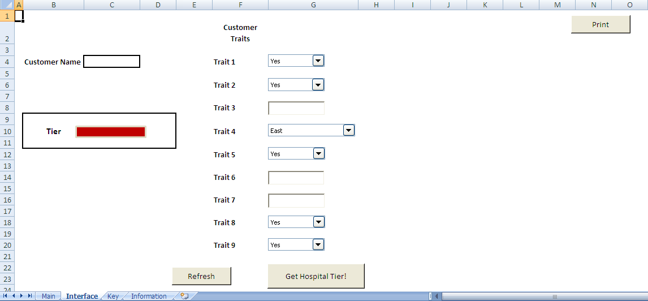
Customer Profiling (3/3)
Mu Sigma helped the clients decide whether to target a hospital at a moment’s notice for its new product launch
Outcomes / Findings / Results
Snap Shots
The target list provided by the customer was segmented into 4 tiers and the best hospitals to target identified
The maximum potential across each hospital was calculated and found to be $ 60 Mil. at the end of 4 years, taking all hospitals into account.
A customer traits database was prepared using which, if the client keyed in a few traits of the hospital, it will give the client the tier in which the customer belongs to.
Customer Traits Tool
Mu Sigma Value Addition
A dynamic tool which takes a host of customer traits like number of beds, etc. as its input was built for calculating any Hospital’s tier. This enables the client to decide whether to target a hospital at a moment’s notice
Exhaustive secondary research, which was commended by the client, was required to finish the project as Mu Sigma had no prior experience in Medical Devices
The project was completed well before the agreed upon time to the client’s satisfaction
Index

Slide 7
Market assessment for Medical devices major(1/2)
For a medical devices major, we assessed the market potential of to-be-launched adjuvant
Background
Challenges
In order to make the go/no-go decision for each market segment, the client wanted to estimate the market potential
The client conducted several primary research studies, identified data sources for sizing and developed a sizing model. However, lacunae in the sizing model led the client to engage Mu Sigma to develop a more robust sizing model and assess market potential
The procedure that the adjuvant is used is very common that it is often not coded; the effect of under-coding had to be addressed
Since the adjuvant therapy under study is a radically new therapy that seeks to replace a well-entrenched procedure, the accessible market is not well defined.
Since no further primary research was commissioned, secondary research had to be relied upon
Approach
Identified Data sources
Identifying Segments
Potential segments were identified based on consultation with the client and on study of medical literature
National Hospital Ambulatory Medical Care Survey – ER (NHAMCS-ER)
National Inpatient Sample (NIS) of Healthcare Cost and Utilization Project (HCUP)
Minimum Data Set (MDS) of the Resident Assessment Instrument (RAI)
Identifying data sources
Robust data sources for sizing the market potential were identified
Outcome
Developing Sizing Model
Sizing model was developed for each of the identified segments based on the identified data sources
Robust data sources and sizing framework along with a sanity check for each segment led to better estimates of market size
The sizing model developed was a significant improvement on the earlier model and was accepted by the client; Mu Sigma’s estimates are now being used to inform launch decisions
Deriving market size estimates
Market size estimates were derived based on the sizing model
Index
Notes:
7
7

Slide 8
Mu Sigma provided a significant value-add in terms of robust data sources, better sizing framework and accurate estimates
Market assessment for Medical devices major(2/2)
Before Mu Sigma’s Involvement
After Mu Sigma’s Involvement
Framework
Market is segmented by Site of Care / Specialty
Sizing uses an epidemiological approach
Potential market size for most segments determined without reference to factors impacting penetration
Data Sources
Secondary Research
Small sample sizes
Accuracy is compromised if projected to obtain national-level estimates
Concerns
Incomplete Market Definition
Accuracy
Estimates based on a single secondary research study
No validation / sanity check
Framework
Market segmented by Site of Care with drivers for adoption used for further segmentation
Sizing based on hydration procedures
Factors that impact penetration are included
Data Sources
Secondary Data Sources
Medium to large sample sizes
Can be projected to obtain national-level estimates
Secondary Research to support data sources
Benefits
Completeness (with validation) of market definition
Accuracy
Robust data sources
Alternate approaches identified for validation
Index

Slide 9
Patient Modeling(1/2)
For a leading Pharma client, we developed a model to estimate the market size of a new product for Bipolar Disorder treatment…
Situation
Approach
Bipolar disorder is a brain disorder that causes unusual shift in a person's mood, energy, and ability to function
About 2.6% of the population older than 18 yrs have bipolar disorder in any given year
It is often not recognized as an illness and people may suffer for years before it is properly diagnosed and treated.
Bipolar disorder typically develops in late adolescence or early adulthood. Like diabetes or heart disease, bipolar disorder is a long-term illness that must be carefully managed throughout a person's life.
Bipolar Disorder is a treatable condition
PATIENT FLOW MODELS TO ASSESS MARKET OPPORTUNITY
Prevalence (% of Population)
Seeking Treatment (%)
Diagnosed (%)
Treated (%)
Drug Treatment (%)
Compliance/Persistence
Cost/Rx
Data Source
Primary/ Secondary Market Research Data
Longitudinal Patient Level Data
Complications
The market has been undergoing significant changes in the past few years
Launch of new classes and formulations
Products seeking secondary indications
The occurrence of these market events may have significant impact on Product X market share.
Discrete Choice Model (Simulator)
Longitudinal Patient Level Data
Brand Marketing Assumption
Key Questions
What is the market size of product X for Bipolar Disorder Treatment taking into account current and future product events?
What is the preference share of Doctors for Product X and its competitors in the Bipolar Disorder market?
Market Size/
Product Forecast
Index
Notes:
9

Slide 10
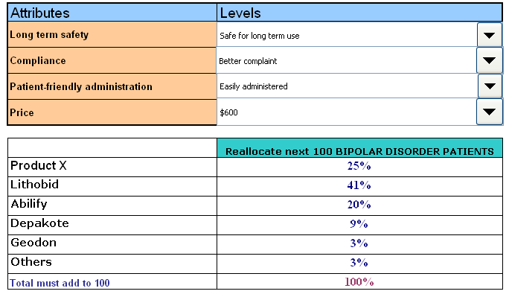
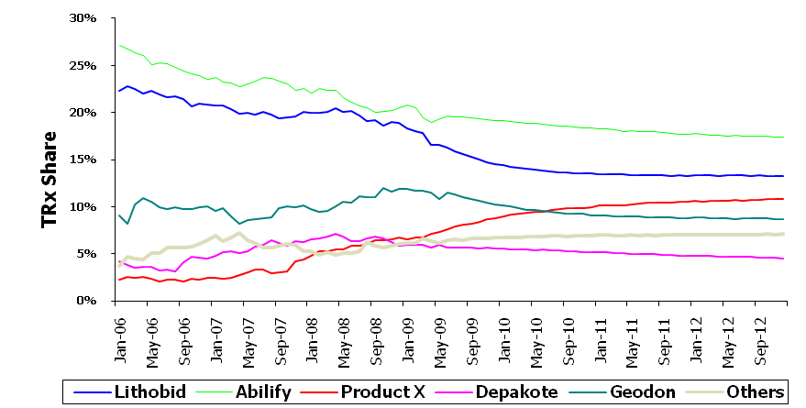
…and forecasted the preference shares through simulation of different attribute level scenarios
Patient Modeling(2/2)
Future Event Impact Forecast: Product X vs. All Products
Takeaways
Bipolar disorder market was forecasted to be $6.6 billion by 2012 taking into account the future events impacts, of which Product X would have a total prescription share of 12%.
Important attributes and their attribute levels were identified for Product X which can give the maximum preference share among physicians from the market
A simulator incorporating attributes and their attribute levels was developed for the client wherein market shares can be predicted for Product X and its competitors for different scenarios
15.4%
Simulator to analyze Preference share for Product X vis-à-vis Competitors
Index
Notes:
10

Slide 11
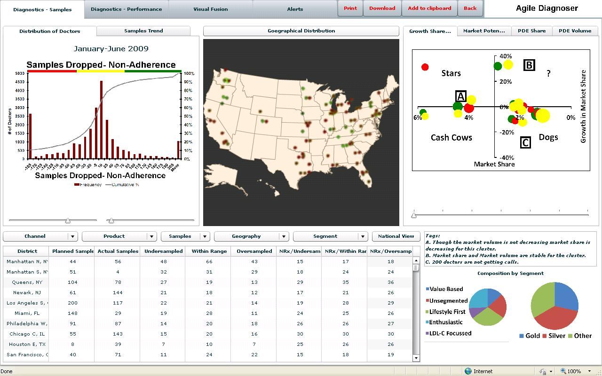
Sales force performance dashboard (1/3)
For a leading pharmaceutical company, Mu Sigma helped their marketing team to track their sales force performance and…
Background
Analytical Approach
A large pharmaceutical company observed a sharp decline in market share for one of their leading cholesterol reduction drug
Drop in sampling was the root cause attributed to this decline in market share
Subsequently, sampling optimization was performed to determine the optimum number of samples to be dropped to a physician
The client required a mechanism to monitor compliance to the optimal plan level
Apply business rules to process this information
Based on business logic, send alert in appropriate delivery form (e.g. pdf report in email, text alert etc)
Provide intuitive dashboard interface with drill down from different levels to visualize the information
Make dashboard available online
Provide role-based access to information
Challenges
A complex sales force hierarchy structure involving multiple teams and super teams made it difficult to monitor and make it actionable
There was no mechanism to automatically trigger alerts in cases where there are non-compliances
Index

Slide 12
Sales force performance dashboard (2/3)
…visualize execution of promotion strategy through an interactive multi-dimensional interface …
High
Low
High
Low
Distribution of doctors by actual – planned samples
Thresholds to segment doctors into Red, Yellow and Green segments
Index

Slide 13
Sales force performance dashboard (3/3)
…that also allowed for drill down from 36000 ft to zip-code using geographical views
High
Low
High
Low
Geographical distribution of doctors by red, yellow and green segments
Drill-down to zip code level view
Index

Slide 14
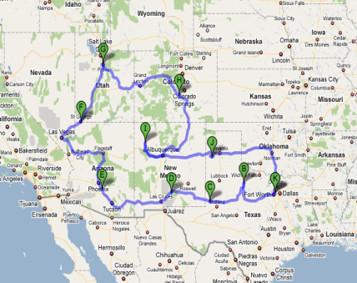
Territory Alignment
Mu Sigma helped a leading pharmaceuticals company align sales force to maximize profitability
Situation
Complication
Key Questions
To support a new product launch, a sales force strategy (targeting, sizing, territory alignment) has been crafted
The sales process has 4 primary stages, i.e. Lead Generation => ID Champions => On P&T Agenda => On Formulary.
This has led to:-
clubbing of territories
whitespace or vacant territories
Less than ideal coverage of targets
Because of practical constraints due to large travel distances, the coverage of high potential accounts may not be high
How to best reallocate reps to territories to cover “whitespace”?
Is the current territory alignment imbalanced or unfair?
How can you optimize the allocation to minimize travel & unmet potential ?
Approach
Whitespace Allocation
Simplify Coverage Path
Optimize Clusters
Identify Frontiers
Whitespace zip codes were mapped to territories considering driving distance only
Based on similarity of responsiveness, product segments were combined
Within each cluster, find the shortest path to cover maximum potential with minimum travel distance
Within each cluster, the hospital accounts can be covered with varying levels of efficiency
Outcome
The size of the sales force recommended by the study was considerably lesser than the original estimate
The Sales Force was aligned by region, district and zip codes
The study helped targeting the right champions which had the highest impact on sales
Index

Slide 15
Promotional Mix Modelling & Budget Planning (1/3)
Mu Sigma helped a leading pharma client determine the optimal allocation of promotional dollars across channels
Background
Objectives
Client is among the top five drug manufacturers in US and markets a blockbuster drug through various promotional channels
They want to assess the importance of each promotional channel that significantly impact revenue
They want to optimally allocate promotional spends in such a way to realize maximum revenue
To identify the promotional channels that have the highest impact on sales
To determine the most cost effective promotional channels
Based on cost-effectiveness, recognize the most efficient promotional mix combination for a fixed marketing budget.
Analytical Approach
Customer Segmentation
Customer Segment Validation
Market Mix Modelling
Promotional Channel Contribution
Response Analysis
Optimization & Scenario building
Perform Customer segmentation based on their responsiveness to various promotional channels during the analysis period, grouping customers into homogeneous clusters
Exploratory analysis is done on the customer segments and segment definition is validated by finding average historical promotional touches across various segments
Modelling is done at customer segment level to obtain the estimates of baseline revenue, and other promotional channels - Details, samples, Direct Mails & other media promotions)
Contribution of each promotional channel to total revenue is estimated at segment level
Response analysis is performed by promotional channel and evaluated to identify optimal level and frequency of promotion
Optimal budget allocation at segment level is performed and multiple resource allocation scenarios are evaluated
Index

Slide 16
Promotional Mix Modelling & Budget Planning (2/3)
Mu Sigma’s integrated marketing mix platform, muMixTM enabled end-to-end process of promotional mix budget planning
Analytical Framework
Latent class segmentation technique is used for segmentation of 150k customers into 5 homogeneous clusters based on their responsiveness to personal and non-personal promotions
A multiplicative market mix model was developed using muMixTM platform for each customer segments using detailing, sampling and different promotional media drivers
Ad-stock was computed based on the decay rate of corresponding promotional variables to account for lag effects
The model results are used to develop response curves for each promotional variable at segment level and relative response to each channel is evaluated
Optimized budgets are recommended as a result of optimization exercise performed for each segment through muMixTM Optimization engine, followed by scenario planning using muMixTM planner
Baseline
Sales
Incremental sales due to various promotional activities
log_{e}(Product TRx) = β₀ +β₁(Spec) + + β2(log_{e}(Managed Care)) +
β3(log_{e}(PDE)) + β4(log_{e}(Sample)) + β5(log_{e}(Media Promotions)) + β6(log_{e}(Direct Mail)) + β7(log_{e}(Email Mail)) + β8(log_{e}(Digital))
Index

Slide 17
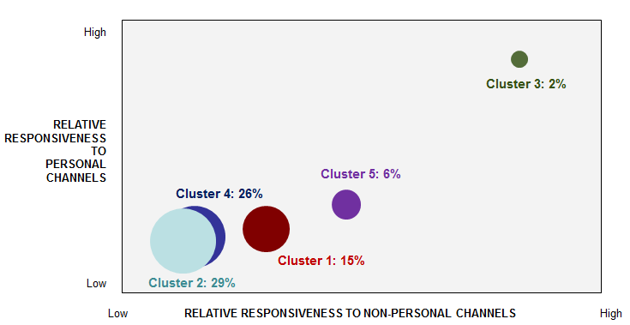
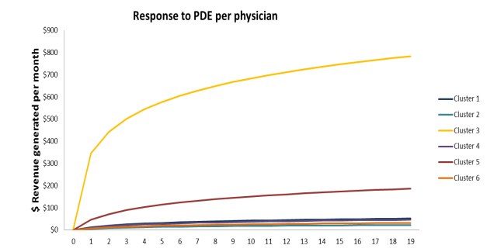
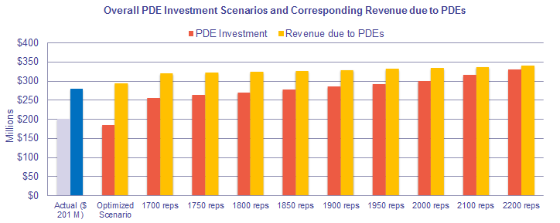
Promotional Mix Modelling & Budget Planning (3/3)
Key insights and recommendations from the analysis helped client improve their allocation strategy and plan the yearly budget
Analysis & Results
Key Findings & Insights
The analysis showcased that overall profitability could be increased by allocating more budget to high responsive segments instead of allocating purely by value
With the reduction of sales force efforts and ensuring full capacity utilization of sales force, both profitability and revenue could be enhanced
Segments with varied degree of promotional response were identified
Mixed model for each of the segments helped in creating response curves to identify optimized budget
Business Impact
Client was able to optimally allocate promotional spend across channels as part of annual budget cycle
Client revised existing call and sample allocations by allocating higher efforts to responsive segments, resulting in a projected incremental sales upwards of $100 MM
Further efficiencies were gained by allocating resources to segments that are likely to respond to various digital media tactics
Multiple budget scenarios depicted the minimal revenue gain even with significant increase in budget
Index

Slide 18
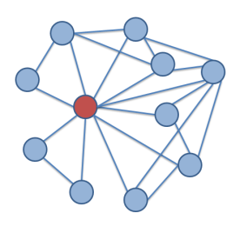
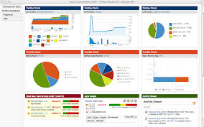

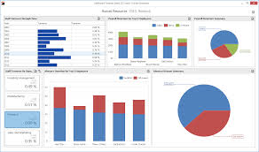
Anomaly Detection corresponding to Product Launch
Mu Sigma proposes a three phased approach to create the anomaly detection system
Phase 1
Phase 2
Phase 3
Objective: Understand the network of business decisions corresponding to product launch
Approach: Create muUniverse of interconnected business problems and deep dive into high priority problems
Outcome: List of problems categorized by urgency and importance
Objective: Solve the most pressing launch-related problems
Approach: Build a scalable discovery driven framework to enable further effective monitoring of these problems
Outcome: Immediately relevant detection system for problems that need to be urgently addressed
Objective: Add other important problem areas and leverage the framework to perform root cause analysis
Approach: Hypothesis for sub-optimal performance found from the discovery driven framework to be validated to understand root cause of discrepancy
Outcome: Such a framework will enable new discoveries from a large amount of data
Analyze interconnected business decisions and understand impact on KPIs
Identify causes of sub-optimal performance
Build a framework that raises alerts in case of anomalies
Index
Notes:
Evaluation of decisions -Interconnectedness of problems
AU was the epicentre of multiple problems
OTP was being impacted the most, it was decreasing
OTP >> airlines is a network phenomena >> systems thinking & simulate
Framework >> problems areas and give surgical actions/recommendations

Slide 19
Mu Sigma helped a pharma company identify right set of physicians to be targeted for its newly launched drug
HCP Targeting for Product Launch
Background
Analytical approach
Client is one of the largest pharmaceutical firms in US and has recently launched a drug in the diabetic market
Client has set-up various marketing activities such as drug detailing, sampling, speaker programs etc., to promote the drug
Client wants to identify the right set of physicians to be targeted through these marketing activities
A 4 step approach was developed to identify the potential prescribers
Identification of the physician universe for the drug
Hypothesis generation and variable creation using analog drug information
Objectives
The key objectives of the exercise were
Develop a model that can identify the profitable physicians for various marketing campaigns
Achieve higher ROI by targeting the identified physicians
Segmentation of the physicians based on their responsiveness to promotions and behavioral pattern
Customization of the target list based on the certain business rules, call plan, territory alignment, etc.
Index

Slide 20
For a leading pharma company, we assessed the impact of various promotional tactics on prescriptions…
Promotional effectiveness for Prescriptions (1/2)
Business Case
Data Preparation
Client markets product A in the immunology space and product B as a cholesterol management agent
Both products are marketed through extensive promotional programs comprised of a mix of Detailing, Sampling, DTC, Journal advertisements, Meetings, Tele-sampling, Web-based promotions etc.
Client wanted to assess the impact of each promotion on incremental prescriptions (sales) and optimize the marketing mix allocation in order to boost ROI
For both products, we received data with 24 months of prescription and promotion information for each relevant physician
Data for promotions, such as DTC and Web, which are not executed at a physician level were provided to us at state, zip or national level.
Data was treated for missing values and outliers and distributions were checked for determining presence of skews, trends and seasonality
Approach
We used a multiplicative model to derive the relative impact of each promotional tactic
TRx = e^{β0(Intercept)}.∏(1+X_{i})β_{i}
Where X_{i} = Promotional stock variables and β_{i} = Parameter estimates
Any promotional data available at physician level, was estimated at segment*decile level. All other promotions were estimated at national level
Promotional stock variables were calculated by selecting appropriate retention rates based on experience & iterations
Dummy terms were included into the model to capture TRx trend, monthly variations and irregular dip observed in September ‘06 and ’07
Lower # days
Unexplained dip
Unexplained dip
Index

Slide 21
… and optimized the allocation of promotional spend to maximize future profits
Promotional effectiveness for Prescriptions (2/2)
Approach (Contd.)
Modeling dataset was broken up into train(80%) and validation(20%) samples (using random samples of physicians)
Appropriate model strength and validation tests were performed
Contribution of each promotion to incremental prescriptions was determined
Promotion allocation was then optimized at segment-decile level by testing various optimization scenarios under business constraints
Incremental profit* of $39.4M
Index

Slide 22
Sales force effectiveness for Specialty TA(1/2)
For a leading pharmaceutical client, we performed a successful re-alignment for its specialty sales force
Background
Analytical approach
The client is a leading pharmaceutical client with an established product in CKD (chronic Kidney disease) market
Product is at the end of its lifecycle stage and its patent is stated for expiry in another 2 years
Due to the upcoming patent expiry & reduced annual budgets, client wanted to reduce the sales headcount and gain productivity improvements
We evaluated pros & cons of two approaches in order to achieve the project objectives:
Resize field force nationally
Re-align existing sales force structure
Later approach was adopted considering the late stage of product lifecycle and minimum impact to existing sales personnel
Evaluate Territory Collapse scenarios
Analyze territory workload balance scenarios
Collapse and retain territories based on workload balance
Disruption analysis
Perform customer disruption analysis due to territory collapse
Estimate territory sales and potential relationship
Sales leadership buy-in
Review proposed scenarios & get sales force buy in
Objectives
To reduce the sales force footprint from 119 to 90 with following considerations:
Minimize customer continuity disruption
Minimum impact on existing field personnel due to resizing
Balanced sales potential & workload
Index

Slide 23
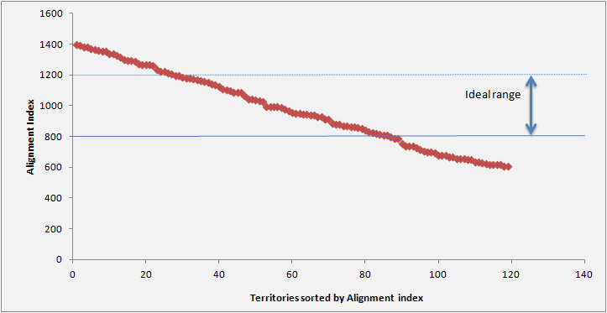
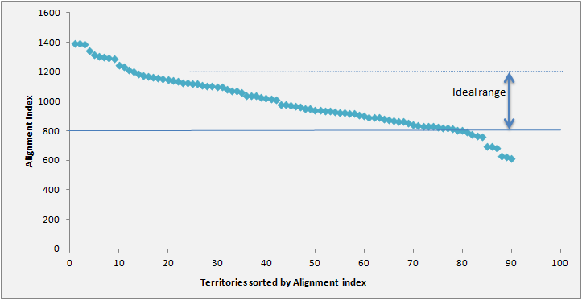
Sales force effectiveness for Specialty TA(2/2)
…improving territory workload-sales potential balance and thus enhancing the productivity
Key Findings
Analysis Illustrations
The spread in territory potential across the sales force indicated that there is potential to re-align by collapsing territories
S curve based on alignment workload index showed the imbalanced workload in the current structure
Customer coverage scenarios showed minimum impact on Rx & customer reach
Territory workload index before re-alignment
Territory workload index after re-alignment
Business Impact
Sales force reduction was achieved with positive impact to overall sales force alignment:
75% of territories were within 20% of ideal territory workload compared to 64% before re-alignment
81% of territories were within 20% of ideal territory sales potential compared to 68% before
Only 20% of the territories observed some level of disruption post re-alignment
Index

Slide 24
Mu Sigma developed a forecasting model for monthly sales for a drug for a leading pharmaceutical company
Forecasting monthly sales
Situation & Key Question
Model Results
The client is one of the leading pharmaceutical company in the US
The annual goal setting exercise required a monthly drug sales target to be established
Their existing model for predicting sales had low predictive power
The client wanted Mu Sigma to develop a sales forecast for the drug under consideration
Analytical Approach
Analytical data set was created using historical sales volume data at monthly level for the past 3 years
Time series ARIMA modeling was used to identify underlying trend, seasonality, cyclical and autoregressive components
Lag transformed macroeconomic variables were used in a regression framework to identify the impact on residuals derived from ARIMA modeling
Significant macroeconomic variable along with AR and MA components were used to forecast monthly sales volume for 2012
Business Impact
The score card assisted team to track drug performance
Improved decision support in scheduling marketing and promotional campaigns
Index

Slide 25
Drivers of new writer acquisition(1/2)
Mu Sigma helped a leading pharmaceutical company to identify the key drivers of new writer acquisition of a launched drug
The client is a leading global pharmaceutical company with a new drug launched into the market
The newly launched drug belongs to the long acting insulin market which is supposed to cannibalize the existing blockbuster drug which recently lost its patent
Understanding the key drivers of new writer acquisition in the initial phase of the launch is critical for the launch to be successful
National Level Model
Area Clustering
Identify different environmental
and execution factors influencing new writers at a national level using logistic regression
Identify groups of similar area
based on environmental factors
Recommendations
Area Level Model
Provide prioritized recommendations for each area with respect to the best performing area in the cluster as the benchmark
Localize the national level model to each group of areas to obtain a unique area level model
Provide the sales team with key drivers of new writer acquisition at a national and area level to enable better control the standard execution levers
Provide guidance to the field force to target physicians with higher propensity of becoming new writers
Index

Slide 26
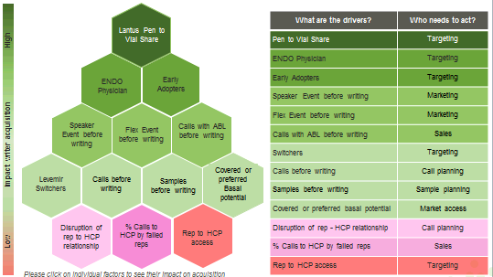
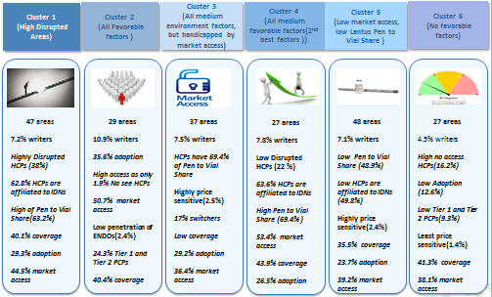
Drivers of new writer acquisition(2/2)
The company is able to target the top prospective physicians and move the most relevant levers in each area
Each group of areas exhibit varied behavior and must have their own execution plans
Some environmental and execution factors have significant influence across all the groups of areas
Certain factors are significant only to a specific cluster while are insignificant to others. This can be used as a cue for the sales team to tweak their execution levers to achieve the desired results
The sales team is able to target physicians who are highly likely to become writers more effectively
The Area Business Leads are able to understand the factors influencing physicians in their respective areas and can train their representatives accordingly
The sale representatives are able to detail the drug more efficiently as they have a better understanding of their territories
Index

Slide 27
Impact of launch of new product on existing mature product (1/2)
For a leading pharmaceutical client, we predicted the impact of new product launch on client’s mature product in the market
Situation
Methodology
The client is a leading healthcare company with sales in more than 130 countries worldwide
Client launched a drug in 2000 and has maintained a steady market share of ~28%
In 2009 competitor launched a new product which has found acceptance in the market
Identify the Source of Business
Determine the Switch pattern
Measure Persistence and compliance
Create Adoption Segments
Complication
Model the rate of adoption for each segment
Quantify loss due to switching
Model prescription trend for physician & other factors (payer, calls etc) within a segment
Predict physicians who might be At Risk
In the recent past the client product has been steadily losing market share
Product has reached maturity, with the patent to expire in 2012 and there are no drugs in the pipeline for the defined market
Complication
Outcome
What is the impact of the new product launch on client product due to switching?
Who are the physicians that are At Risk of moving from client product to competitor product
Decision support on
Quantifying threat from new product and areas of concern
Identifying doctors at risk, before they switch to competitor
Business impact
Curbed market share loss
Increased ROI of sales force effort
Index

Slide 28
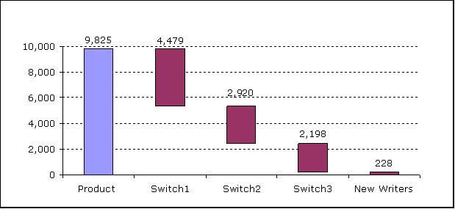
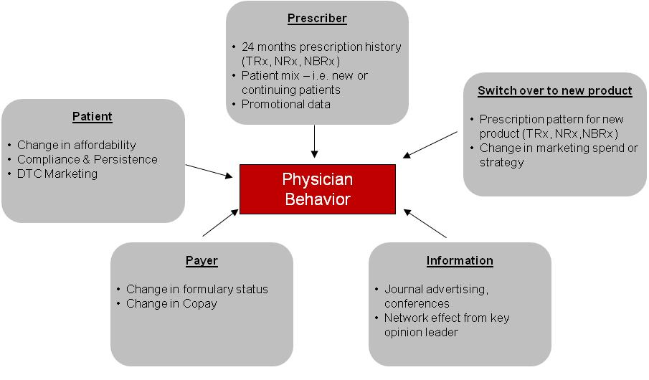
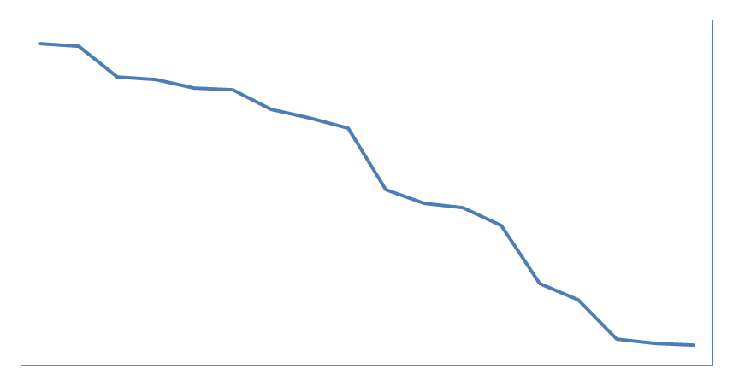
Impact of launch of new product on existing mature product (2/2)
We developed adoption based models to quantify overall potential loss and identify physicians “At Risk” of switching
1
Adoption curve based models to quantify overall potential loss to existing drug on the account of new drug launch
Adoption curves by physicians segments
Switch over analysis to new drug
Persistency analysis
MD Count
% Persistent
Potential loss = Fn (Rate of adoption, Persistency, compliance)*Fn (Switch over) Rate of adoption = Fn ( number of early adopters, number of late adopters, initial growth rate of each wave, late stage growth rate)
2
Physician level modeling to identify physicians “At Risk” of switching over to new drug
flag the physicians at this point to allow pro-active action
Composite “At Risk” Index
TRx Share
Past
Present Day
Future
Index

Slide 29
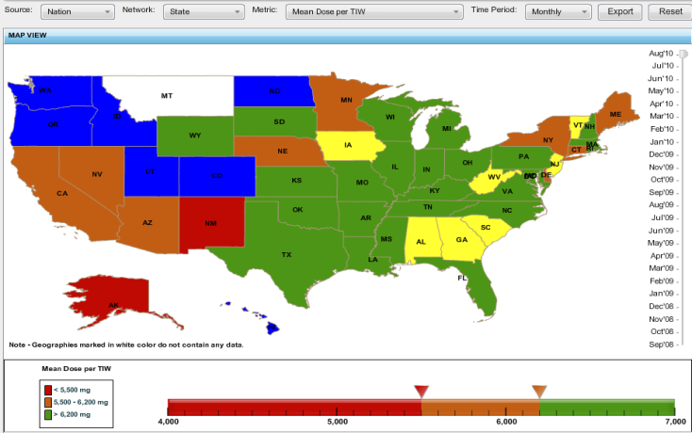
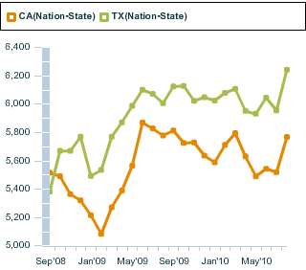
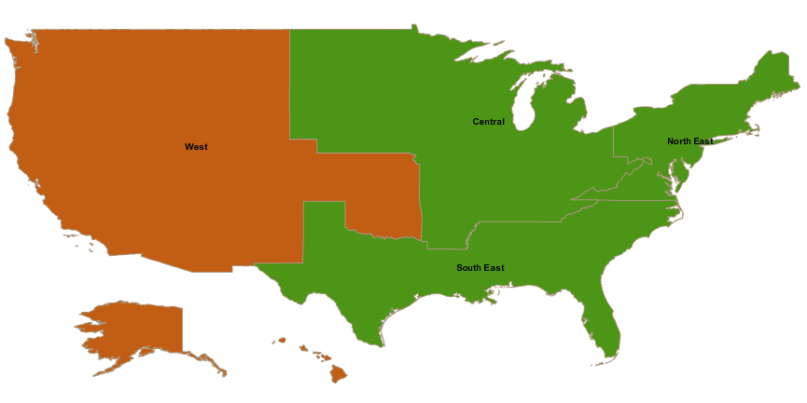
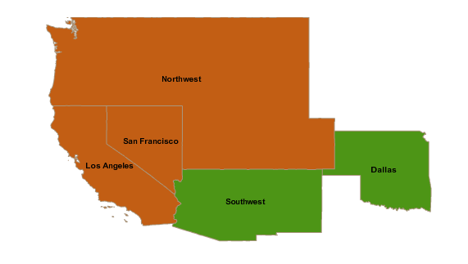
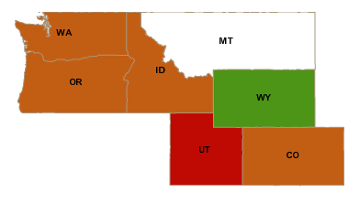
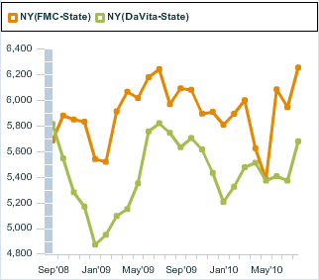
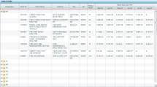
Heat maps to track product’s performance
Mu Sigma developed a heatmap dashboard for a bio-tech client to track product’s performance based on KPIs at a sub-national level
Situation
Complication
Key Questions
Desired Future State
Product A is a drug prescribed for patients suffering from Chronic Kidney Disease
Client wanted to develop a heat map dashboard which offers flexibility to track and compare various KPI’s across different geographies and time periods
Product A is facing stagnant growth in a rapidly changing environment.
National level analysis and high level segmentation do not provide enough detail to make the optimal decisions
What are the key indicators of Product A’s performance w.r.t. Sales, Payor and Call activity?
What are the different time periods and views in the heat map for comparison of metrics?
The client has identified appropriate KPIs to track geography performance over a period of time
The client has an interactive dashboard to track and compare KPIs across various geographies and time periods
Descriptive functionality
Cross sectional and time series analysis
Geography granularity up to facility level
Analytical ability
Geography / Facility performance comparison
Top and bottom performing accounts / territories
Visualization, Effectiveness and Efficiency
Rich visualization and easy portability to online
Meaningful and better representation of patient level data with faster data processing ability
1
2
3
Geographies are colored based on the performance of the metric and enable the user to have a holistic view
Trend charts help the user to compare the performance of metric across geographies and also the performance of facility groups of a given geography
A double click on geography helps the user traverse across various geography hierarchies and track the performance up to facility level.
Index

Slide 30
For a global Pharma client, we developed a model to understand the compliance and persistence across different countries…
Patient Compliance (1/2)
Situation
Approach
Chronic Obstructive Pulmonary Disease (COPD) is a group of diseases characterized by the pathological limitation of airflow in the airway that is not fully reversible.
1-2% of the population worldwide suffers from COPD (2005 statistics). In the UK, COPD accounts for about 7% of all days of sickness related to absence from work*
Drugs like Bronchodilators, Corticosteroids, Antibiotics are used for treatment of COPD
Data
Patients level longitudinal treatment data from GPs:
ICD – 10 code J40 – J44
Prescribed drug
Hospital/specialist - referrals*
Days of supply
Data Preparation
Data cleaning and validation
Define study and recruiting periods and Rx duration
Define inclusion/exclusion criteria and definition of non-persistence
Complications
Compliance/ Persistence Analysis
Compliance was compared across the focus countries
Multiple regression analysis was used to determine factors that impact compliance
Persistence analyses established patient attrition curves over a 12-month period
Cox proportional hazards analysis was used to compare differences in persistence
Effectiveness of a drug is dependent on compliance and persistence of the patient
COPD could lead to complications including wheezing, cough and shortness of breath, and could result in hospitalization of the patient.
Key Questions
How do the 3 primary brand drugs which are used to treat COPD compared at a country level, in terms of patient compliance and persistence?
What is the impact of sub optimal compliance and persistence on the product performance?
Impact on product performance
Patients were segmented based on their compliance and persistence profile
A logit model was used to determine the relationship between compliance/persistence and hospital/ specialist referrals while controlling for other factors
*Source: World Health Organization (WHO)
+ Hospitalization information is incomplete. This data source only captures physician referrals to hospitals and specialists.
Index
Notes:
30
30

Slide 31
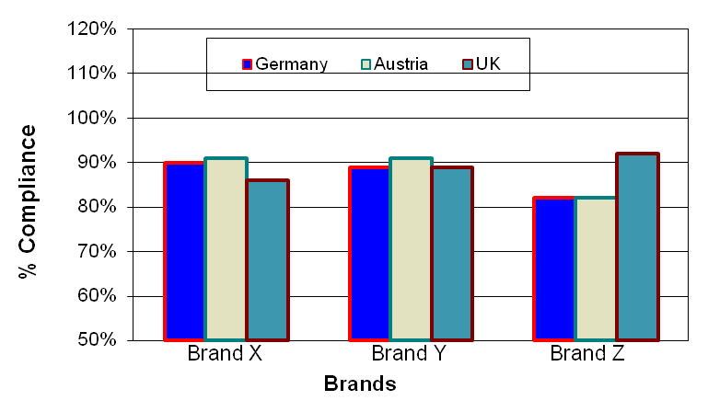
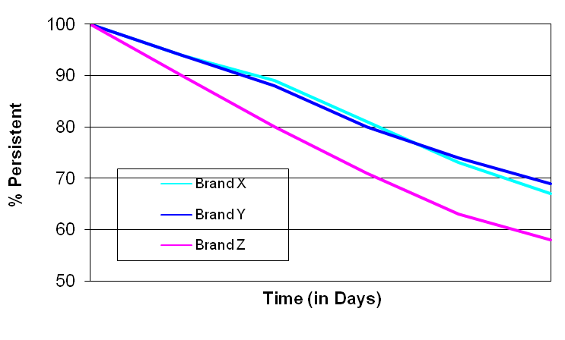
…and found that lower compliance contributed to more referrals to a hospital or a specialist
Patient Compliance (2/2)
Persistence rate among three brands in the UK
Takeaways
Compliance/Persistence Findings
Most brands have a similar persistence and compliance profile in Germany and Austria.
Brand Z has significantly lower persistence in the UK, but not in other countries
Early switches from Brand Z to alternate treatments contribute to lower persistence
Brand Z (UK) has the highest compliance. However, Brand Z compliance is lower than the competition in other countries.
Implications of Compliance and Persistence
We observed that persistence did not have a significant impact on hospital/specialist referrals
Compliance, however, did show an impact. The lowest compliance segment showed a higher likelihood of referrals than the high compliance segment.
Compliance Comparison
Index
Notes:
31
31

Slide 32



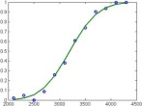
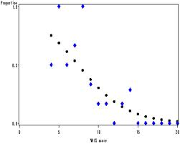
Mu Sigma has designed and developed a call plan process for multiple sales forces of a leading pharmaceutical company
Call planning & Tracking(1/2)
The client is a leading pharmaceutical company with multiple sales forces catering to a diverse product portfolio
A call planning exercise was undertaken every semester to identify targets for each sales rep
The existing call planning process is based on a rule based approach and executed in a ad hoc manner for each sales force/BU leading to inefficiencies and loss of information across semesters
1
Data Treatment
Data gathering
Verify sanity of data using automated SAS codes
2
Segmentation
K-means segmentation of customers based on attributes like customer’s historical product and market prescription, specialty, demographic, KOL status
3
Response Curves
Generalized linear models used for studying ROI based on statistically significant customer attributes and sales rep customer relationship
4
Phy-Rep Alignment
Physicians are aligned to teams based on geography, specialty
Physicians aligned to more than two sales teams within one sales force are re-aligned to only two teams, with minimal physician - sales rep relationship disruption
Design and develop a call plan framework that works across sales team detailing multiple products
Develop an optimization algorithm to obtain maximum ROI through calls assigned to sales reps
Develop call plans ensuring minimal disruptions to maintain physician-rep relationship
Workload constraint
Customer attributes
Relationships
5
Call Allocation
ROI maximized with customer attributes, workload constraint and relationship as constraints to optimize calls
Index

Slide 33
A scalable and flexible framework for call plan ensured a faster turnaround and provided scope for further refinement
Call planning & Tracking(2/2)
Call activity data was considered to map physician and sales rep instead of random allocation which resulted in a overall of only 30% disruption
Addition of 20-30 physicians per rep call plan through inclusion of Group Practioner Affiliation physicians
ILLUSTRATION
A efficient call plan for various sales team to be in sync with brand objectives
Faster turnaround time (reduced the turnaround time from 2 months to ~3 weeks for 4 sales teams) for creating a call plan
Minimal errors and simplified execution through implementation of a single call plan framework for multiple teams
Index

Slide 34
Customer Centric Digital Marketing Modeling
Predictive models were built which enabled brand teams to design the slides based on simulated interaction between the rep and physician
Approach
Drivers for showing Message A over Message B
Based on historic interactions between the rep and customer, their characteristics, the story to be shown in the next interaction is predicted using binary or multinomial logistic models
Drivers that lead to a particular story being conveyed are identified and their impact is quantified
The models developed have a high adjusted r square count and hit-rate of 85% making it a good predictive model
Findings and Next Steps
The most significant variables which drives the story being conveyed in the next interaction are rep’s historical detailing behavior
It was concluded that interactions are majorly driven by reps
Reps tend to repeat the story in various interactions
IMPACT
Brand teams were able to refine content by understanding current interaction dynamics and having future vision
Presentation content was reduced by around 50%, leading to cost reduction
Index

Slide 35
Placement framework(1/2)
Mu Sigma developed a single placement framework capable of addressing all the placement needs of a pharmaceutical client
The client is among the top 5 pharmaceutical companies in the US and has over 4,000 sales personnel in 50 different sales teams
The client wanted to restructure and resize 7 of its sales teams which detailed most of the blockbuster products
The client had rolled out a voluntary severance scheme where the sales personnel could either choose to stay and be eligible for placements (opt-in) or accept the severance package (opt-out)
Two sets of business rules were applied
Eligibility rules which decide whether a rep is eligible for a territory or not
Priority rules which decide the most eligible rep for a territory
Every sales rep was mapped to every territory and the business rules parameters for every rep territory combination were calculated or obtained as the case maybe
Eligibility rules were applied and rep territory combinations that were infeasible were ignored
Priority rules were applied and the rep territory combinations were ranked in the order of preference
This rank was used as the cost element for the assignment matrix of reps vs. territories
This matrix was solved using the Hungarian Algorithm to get a one to one mapping of reps to territories
Find the most eligible sales rep that can be placed in the vacant territories
Decide if a sales professional who has opted in to the program can be let go based on availability of replacements
Maximize performance rating at a national level
Index

Slide 36

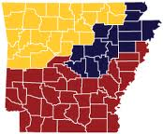
The placement process was designed to be modular, flexible and scalable to handle different types of placement scenarios
Placement framework(2/2)
The severance requests of all 205 Sales reps and 16 District sales managers who opted in were accepted
261 Sales reps and 34 District sales managers who could not be placed were let go
225 Vacant territories were filled and the average PRW for these territories was 3.3 on a scale of 5
Applying the eligibility rules and priority rules helps us identify the feasible rep territory combinations and rank them
The Hungarian algorithm gives the most optimum allocation of rep to territory
The cost of assignment in the above situation is 10 which is the minimum among all possible combinations and hence is chosen as the solution
R4
1
4
R2
5
8
9
2
6
R1
7
R3
3
The scalable nature of the placement framework ensured that placements for all 7 sales teams could be executed in a single run
The diagnostics module provided recommendations in terms of tweaking the business rules to enable more placements
Alternative solutions were suggested, giving the management more flexibility in decision making
R4
1
6
R1
R3
3
Index

Slide 37
Mu Sigma helped a leading pharmaceutical company to address the gap in sales force execution to ensure early adoption of a launched drug
Factors influencing early adopters (1/2)
The client is a leading global pharmaceutical company with a new drug launched into the market
The newly launched drug belongs to the long acting insulin market which is supposed to cannibalize the existing blockbuster drug which recently lost its patent
Sales team needed to understand the factors influencing early adopters
Geo categorization: Areas were categorized into High,
Medium, Low and Bottom performers based
on the overall TRx
Execution benchmarking: Benchmark was identified
after removing extremely high or low executing areas
Gap Analysis: Areas were categorized into High
or Low execution based on the deviation of from the
benchmark
Execution indexing: Derived execution flag was
created by combination of all the execution flags
Provide directional input to the sales leadership with the various factors that is making physicians prescribe the newly launched drug
Provide an understanding of how these factors are affected by various levels of the standard execution levers in the control of the sales team
Recommendations: Recommendations to bridge the
gap in execution
Index

Slide 38
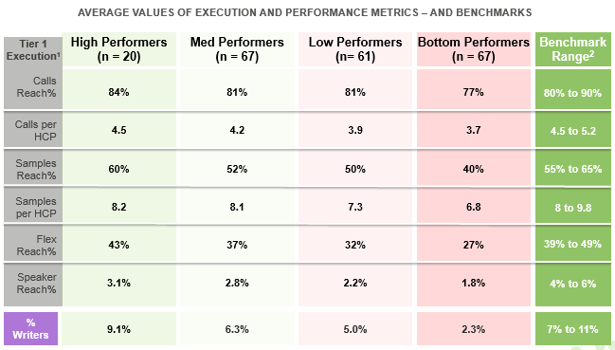
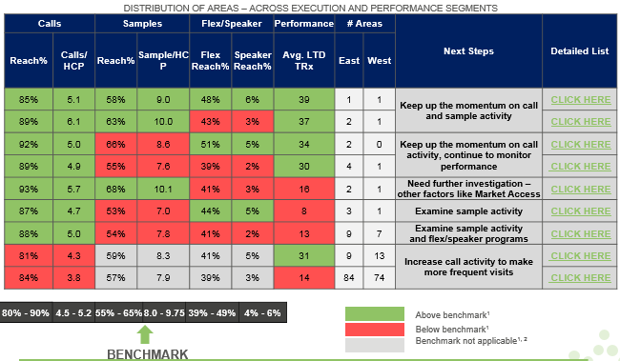
Factors influencing early adopters (2/2)
The company is able to identify the relevant execution gaps in each area and create a plan of action
Performance in each area was influenced by the levels of execution in terms of detailing, sampling, flex funds and speaker programs
Areas are flagged based on their performance into categories such as:
HHHH
HHLL
LLLL
The sales team has a clear understanding of how to close the gap in execution between different areas
The sales team is able to control the execution levers better to achieve higher performance in each area based on the category assigned
Index

